Slide 1




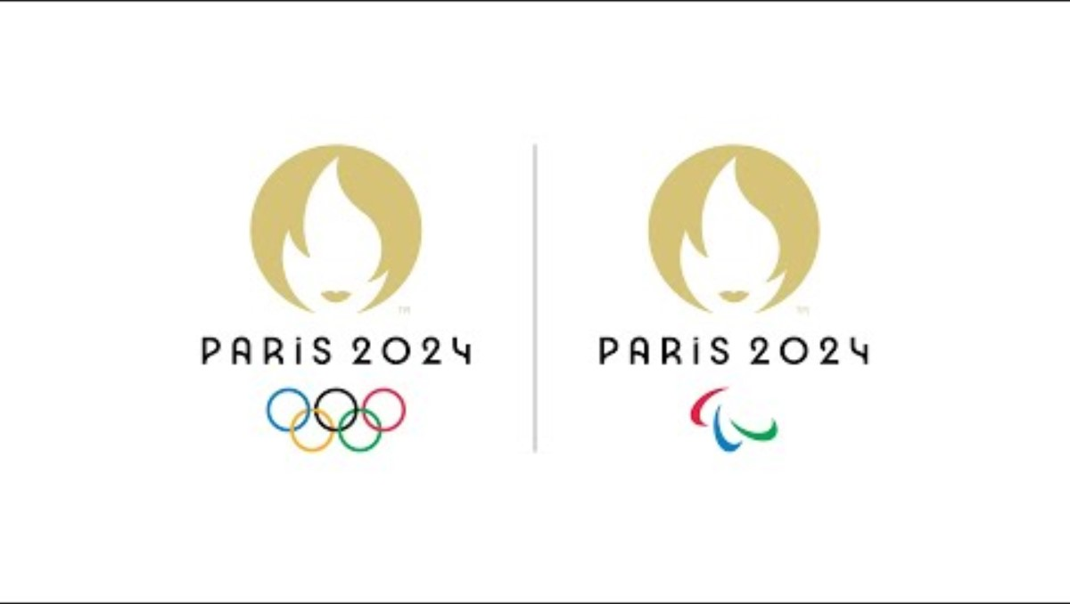
AI BOOTCAMp / TEam 1
TEAM: Angelica padilla; matilda wang; jeff destine; dennis shen; sebastian fajardo
2024 Summer olympic medal prediction
Utilizing machine learning for olympic success prediction
Notes:
The logo for Paris 2024 combines three separate symbols – the gold medal, the flame and Marianne, the personification of the French Republic. Each of these symbols reflects a part of our identity and values. It is also the first time in history the same emblem has been used for both the Olympic Games and the Paralympic Games.
THE GOLD MEDAL – SYMBOLISING ACHIEVEMENT
It is the example set by our Olympic and Paralympic athletes, the heroes of the Games. By excelling themselves and improving their personal bests, they demonstrate that everyone has a chance of winning. We all remember Renaud Lavillenie sealing the Olympic title on his last attempt at the London Games, or Marie Amélie Le Fur, who won three golds and set two new world records at the Paralympic Games in Rio.
But the medal for the Paris 2024 Games isn’t reserved solely for champions. It is there to reward all those who give everything they have and enable others to do the same.
THE FLAME – SYMBOLISING THE ENERGY WE SHARE
The Olympic and Paralympic flame carries a powerful message. Different people see different meanings and feel different emotions about the flame. Who could forget Cathy Freeman, the Indigenous athlete chosen to run the anchor leg in the relay at Sydney in 2000, or the Paralympic Archer Antonio Rebollo, who lit the torch by firing an arrow in Barcelona in 1992.
The flame symbolises the unique energy that drives this mega event, encouraging us to be bold and forge a new way of organising the Games to rise to the challenges we face today.
MARIANNE – SYMBOLISING FRANCE
Marianne is the personification of the bold spirit of creativity that inspires our Games. Marianne, symbol of the French Republic, represents the same values we find in sport, the Olympics and the Paralympics – humanism, fraternity, generosity and sharing. Marianne is a familiar face in French culture that is omnipresent in day-to-day life, appearing on stamps and outside every town hall for example. She reflects our desire to organise the Games for the people, in close collaboration with the people.

Slide 2
Today's agenda
Executive Summary: Project Scope and Goals
EDA Approach & Methodology: Summary of Project Plan and exploratory data analysis process
Model Selection and Performance
Key Insights & Implications - Results of the analysis
Conclusion & Next Steps - Main takeaway and plan for project improvement
Notes:
Here is what we’ll be covering today, aligning to the project requirements:
Content:
The Summer Olympic Games are the pinnacle of international sports competition.
Objective: Develop predictive models to estimate the 2024 medal counts for the top five medal-winning countries.
Models used: Linear Regression, Random Forest Regressor, XGBoost Regressor.
Goal: Achieve precise predictions using past data from 1896-2012.

Slide 3
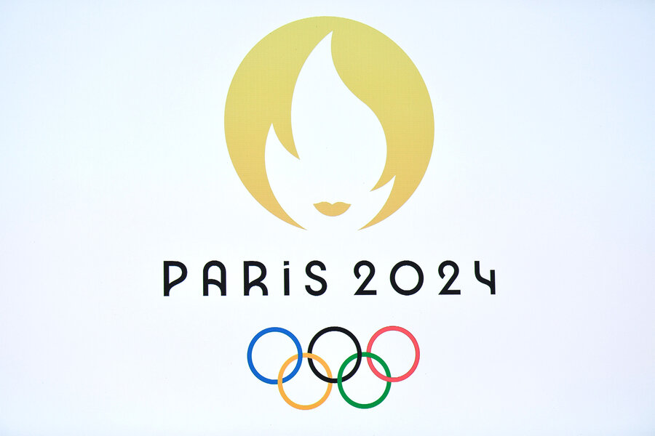
Executive summary
The Summer Olympic Games represent the pinnacle of international sports competition, where athletes from around the world compete for glory and national pride.
Our goal with this project is to develop predictive models that can estimate the 2024 medal counts for the top five (USA, URS, GBR, FRA, GER) medal-winning countries based on past data (1896-2012).
By leveraging machine learning algorithms, specifically LinearRegression, RandomForestRegressor, and XGBoostRegression, we aim to achieve precise predictions.
Notes:
This project utilizes historical Olympic data and advanced machine learning models (Linear Regression, RandomForestRegressor, XGBoostRegression) to accurately predict the number of medals of top countries who have historically won the most medals and we predict will win in the 2024 Summer Olympics, emphasizing the identification of key predictors for medal success.
Scope: Analyze historical Summer Olympics data to forecast future medal counts.
Goals:
Understand historical trends and patterns in Olympic medal counts.
Develop machine learning models to predict 2024 medal counts.
Compare model performance and select the best predictive model.
Our primary goal was to discover/answer the following questions:
1.How many medals will each country win? Top 5
2.which country wins the most gold?
3.which country wins going to win the most silver?
4.which country wins going to win the most bronze?

Slide 4

EDA Approach & Methodology
Model Choice/ Feature Selection:
Linear (Simple, good baseline - model struggled with the complex relationships in the data resulting in higher MSE & Lower R-Squared values).
Random Forest: Multiple decision trees to improve prediction accuracy & control overfitting. Able to manage high-dimensional data. Much better model than Linear with lower MSE and higher R-squared Value
XGBoost Regressor: (Winner) An advanced implementation of gradient boosting. More speed and performance. Handles non-linear, missing values, various data types - best choice for complex datasets. Outperformed Linear & Random Forest
Training Process:
Data Processing – handling Missing values, Encoding Categorical Variables, Ordinal Encoding (Gold, Silver, Bronze); Outliers were removed (1904 and 1984)
Feature Engineering - Relevant Features were selected (medal counts), Data Splitting into training (80%) and testing sets (20%) to evaluate model performance and unseen data
Model Training and Hyperparameter Tuning - Each model (Linear Regression, Random Forest, XGBoost) was initially trained on the training set.
For Random Forest, a GridSearchCV was used to find the best combination of parameters (n_estimators, max_depth, min_samples_split, min_samples_leaf).
For XGBoost, a RandomizedSearchCV was employed to tune parameters (n_estimators, max_depth, learning_rate).
Model Evaluation - Cross-Validation: Cross-validation was performed to ensure the model’s robustness and avoid overfitting.
Performance Metrics: The models were compared based on MSE and R-squared values, with XGBoost emerging as the winner due to its superior performance.
Time Series Forecasting – Prophet Model, predict future medal counts, this model was used due to its ability to handle time series data effectively. Provided forecasts and insights into trends and seasonal patterns.
Notes:
EDA Approach
We leveraged a Kaggle data set, spanning over 100 years with Country, Year and Medal count as parameters
Ouliers: Points on 1984 : The 1984 Summer Olympics are widely considered to be the most financially successful modern Olympics,[4] serving as an example on how to run an Olympic Games. As a result of low construction costs, due to the use of existing sport infrastructure, coupled with a reliance on private corporate funding,[5] the 1984 Games generated a profit of over US$250 million. Many communist countries—including the Soviet Union, East Germany, and Cuba—retaliated for the U.S.-led boycott of the Moscow 1980 Games by staying away from the 1984 Games, citing concerns over the safety of their athletes in what they considered a hostile and fiercely anticommunist environment. China, however, participated in the Summer Games for the first time since 1952. In all, nearly 6,800 athletes representing 140 countries came to Los Angeles. The number of events for women grew to include cycling, rhythmic gymnastics, synchronized swimming, and several new track-and-field events, most notably the marathon.
Methodology
We collectively agreed to the project in mind, kicked off with project ideation, and spending a bit of time analyzing the data and agreeing which values need to be removed.
Model Choice
For our project, we explored three different machine learning models to predict medal counts: Linear Regression, Random Forest Regressor, and XGBoost Regressor. Here’s why we chose each model and the outcomes:
Linear Regression:
Choice Rationale: Linear Regression is a simple and interpretable model. It establishes a linear relationship between the features and the target variable, making it a good baseline model.
Outcome: While easy to interpret, the model struggled with the complex relationships in the data, resulting in higher Mean Squared Error (MSE) and lower R-squared values compared to the other models.
Random Forest Regressor:
Choice Rationale: Random Forest is an ensemble method that uses multiple decision trees to improve prediction accuracy and control overfitting. It handles non-linear relationships well and can manage high-dimensional data.
Outcome: The Random Forest model performed better than Linear Regression, with lower MSE and higher R-squared values, indicating a better fit to the data.
XGBoost Regressor (Winner):
Choice Rationale: XGBoost is an advanced implementation of gradient boosting, known for its speed and performance. It effectively handles non-linear relationships, missing values, and various data types, making it a robust choice for complex datasets.
Outcome: XGBoost outperformed both Linear Regression and Random Forest. It achieved the lowest MSE and the highest R-squared values, making it the best model for our predictions.
Feature Selection
The features used in the model were carefully chosen based on their relevance and impact on the prediction of medal counts. Here’s a detailed explanation of the features:
Year:
Reason: The year of the Olympics is a fundamental feature as it captures the temporal aspect of the data, helping the model understand trends and changes over time.
Country:
Reason: The country is a critical feature as different countries have varying levels of investment in sports, athlete training, and participation rates, which directly influence their medal counts.
Sport:
Reason: Different sports have different numbers of events and participation rates. Including the sport as a feature allows the model to account for these variations.
Gender:
Reason: Gender is an essential feature as it influences the number of events and participation rates, and hence, the medal distribution.
Medal:
Reason: The type of medal (Gold, Silver, Bronze) provides granular detail on performance levels, which is crucial for accurate predictions.
Training Process
The training process involved several key steps to ensure the models were trained effectively and provided accurate predictions. Here’s an overview:
Data Preprocessing:
Handling Missing Values: Any missing values in the dataset were addressed to ensure complete data for training.
Encoding Categorical Variables: Categorical variables such as Country, Sport, and Gender were encoded using OneHotEncoder to convert them into numerical format, which is required for most machine learning algorithms.
Ordinal Encoding: The Medal feature was ordinally encoded to represent the hierarchical nature of the medals (Gold, Silver, Bronze).
Feature Engineering:
Feature Selection: Relevant features were selected based on their importance and impact on the target variable (medal counts).
Data Splitting: The dataset was split into training and testing sets (80% training, 20% testing) to evaluate model performance on unseen data.
Model Training and Hyperparameter Tuning:
Initial Model Training: Each model (Linear Regression, Random Forest, XGBoost) was initially trained on the training set.
Hyperparameter Tuning:
For Random Forest, a GridSearchCV was used to find the best combination of parameters (n_estimators, max_depth, min_samples_split, min_samples_leaf).
For XGBoost, a RandomizedSearchCV was employed to tune parameters (n_estimators, max_depth, learning_rate).
Evaluation: The models were evaluated on the testing set using metrics such as Mean Squared Error (MSE) and R-squared to determine the best performing model.
Model Evaluation:
Cross-Validation: Cross-validation was performed to ensure the model’s robustness and avoid overfitting.
Performance Metrics: The models were compared based on MSE and R-squared values, with XGBoost emerging as the winner due to its superior performance.
Time Series Forecasting:
Prophet Model: For predicting future medal counts, the Prophet model was used due to its ability to handle time series data effectively. It provided forecasts and insights into trends and seasonal patterns.
By following this comprehensive methodology, we ensured that our model predictions were accurate and reliable, providing valuable insights for the 2024 Summer Olympics medal predictions.

Slide 5
Model Selection and Performance
Evaluated Linear Regression, Random Forest Regressor, and XGBoost Regressor.
Used GridSearchCV for hyperparameter tuning.
Metrics: Mean Squared Error (MSE), R-squared.
Fitting 5 folds for each of 108 candidates, totalling 540 fits Random Forest Regressor Best Parameters: {'max_depth': None, 'min_samples_leaf': 1, 'min_samples_split': 5, 'n_estimators': 300} Mean Squared Error: 15.959894565955961 R-squared: 0.739627182985269 Fitting 5 folds for each of 27 candidates, totalling 135 fits XGB Regressor Best Parameters: {'learning_rate': 0.2, 'max_depth': 9, 'n_estimators': 300} Mean Squared Error: 11.153143765931201 R-squared: 0.8180454483013779

Slide 6
Model Performance Comparison
Comparison of model performance based on MSE and R-squared.
Highlight the best performing model.
Table:
Model | Mean Squared Error | R-squared
Linear Regression | 25.93 | 0.36
Random Forest Regressor | 16.19 | 0.74
XGB Regressor | 15.12 | 0.76

Slide 7
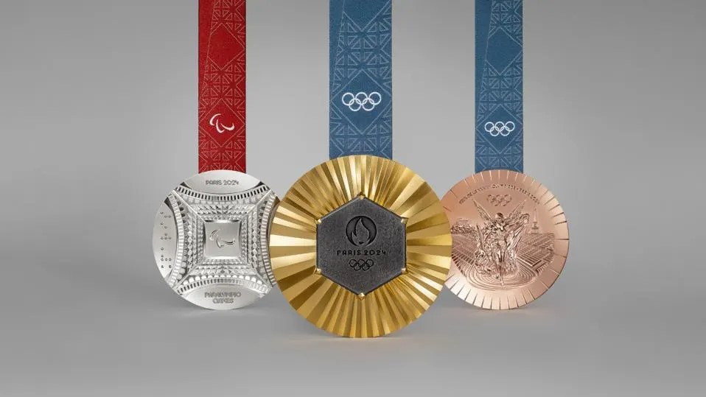
Prediction outcome – top 5 countries in the 2024 Olympics
USA:
Predicted Medals: 253
Historical Insight: Consistently high medal counts over the years, showing strong performance in various sports.
URS (former Soviet Union):
Predicted Medals: 447
Historical Insight: Historically strong performance before the dissolution, with high medal counts particularly in the mid-20th century.
GER (Germany):
Predicted Medals: 148
Historical Insight: Steady performance over the years, strong in both individual and team sports.
FRA (France):
Predicted Medals: 48
Historical Insight: Moderate medal counts with peaks in specific Olympic years.
GBR (Great Britain):
Predicted Medals: 28
Historical Insight: Significant improvements in recent decades, especially in sports like cycling and rowing.
Notes:
Steps and Outcome for Top 5 Countries 2024 Olympic Medal Prediction
Steps
Data Preprocessing and Exploration:
Load Data: The dataset containing historical Olympic medal data from 1896 to 2012 was loaded.
Drop Unnecessary Columns: Columns like City, Discipline, Athlete, and Event were dropped to focus on relevant features.
Group Data: The data was grouped by Year, Country, and Medal to get the medal count for each country per year.
Select Top 5 Countries: The top 5 countries with the highest total medal counts were identified: USA, URS, GBR, FRA, and GER.
Time Series Forecasting:
Prepare Data for Prophet: For each of the top 5 countries, the medal count data was prepared for the Prophet model.
The Year column was converted to datetime format.
The dataframe was renamed to match Prophet’s expected column names (ds for dates, y for values).
Fit Prophet Model: A Prophet model was fitted for each country’s data to predict future medal counts.
Generate Future DataFrame: A future DataFrame was created to hold predictions for the years up to 2024.
Forecast Medals: The model generated forecasts, including predictions for the year 2024.
Model Evaluation and Cross-Validation:
Cross-Validation: Cross-validation was performed on the Prophet model to evaluate its accuracy and robustness.
Calculate Metrics: Mean Absolute Error (MAE), Mean Squared Error (MSE), and Root Mean Squared Error (RMSE) were calculated to assess the model's performance.
Aggregate Predictions:
Extract 2024 Predictions: Predictions for the year 2024 were extracted for each of the top 5 countries.
Compile Results: The predictions were compiled into a DataFrame and sorted by predicted medal counts.
Outcome
The predictions for the top 5 countries in the 2024 Olympics based on the historical data and the Prophet model are as follows:
USA:
Predicted Medals: 253
Historical Insight: Consistently high medal counts over the years, showing strong performance in various sports.
URS (former Soviet Union):
Predicted Medals: 447
Historical Insight: Historically strong performance before the dissolution, with high medal counts particularly in the mid-20th century.
GER (Germany):
Predicted Medals: 148
Historical Insight: Steady performance over the years, strong in both individual and team sports.
FRA (France):
Predicted Medals: 48
Historical Insight: Moderate medal counts with peaks in specific Olympic years.
GBR (Great Britain):
Predicted Medals: 28
Historical Insight: Significant improvements in recent decades, especially in sports like cycling and rowing.
Visualization and Analysis
Medal Count Trends: Visualizing the historical and predicted medal counts for each country highlighted trends and variations over the years.
Forecast Components: The Prophet model’s components plot showed yearly trends, highlighting seasonal effects and other influencing factors.
Model Performance Metrics: The calculated metrics (MAE, MSE, RMSE) provided insight into the model's accuracy and reliability.
This comprehensive analysis and forecasting approach allowed us to generate robust predictions for the 2024 Summer Olympics, providing valuable insights into expected country performances.

Slide 8
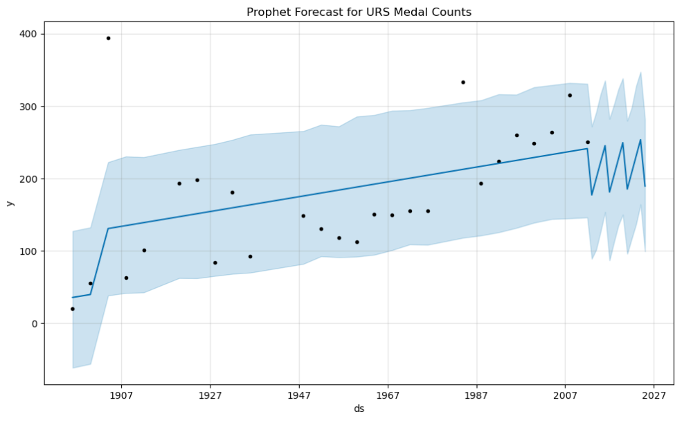
Time Series Forecasting Using Prophet - Russia/URS top contender
Russia (URS) emerged as the top contender based on the analysis and predictions.
Model Fitting; Created a Prophet model for Russia (URS). Trained the model using historical medal counts.
Forecasting: Generated future data for predictions up to the year 2024. Obtained predicted values, including upper and lower bounds.
Analysis and Findings: Model indicated strong upward trend for Russia medal counts, reflecting historical dominance.
Predicted Medals for 2024: Russia (URS): 447 medals
Model Evaluation Metrics:
Mean Absolute Error (MAE): 77.36
Mean Squared Error (MSE): 11,480.23
Root Mean Squared Error (RMSE): 107.15
Medal Count Trends: The time series plot showed consistent high performance with peaks in mid-20th century.
Forecast Components:
Trend: Steady increase in medal counts over the years.
Yearly Component: Highlighted significant spikes during specific Olympic years.
Seasonality: Captured periodic variations, emphasizing the impact of different sports seasons and events.
Notes:
Time Series Data Analysis Using Prophet Model: Russia (URS) as Top Contender
Overview
Objective: Utilize the Prophet model to predict medal counts for the 2024 Summer Olympics.
Focus: Russia (URS) emerged as the top contender based on the analysis and predictions.
Data Preparation
Historical Data: Medal counts from 1896 to 2012 for the top-performing countries were used.
Preprocessing: Data was cleaned and grouped by year and country to obtain annual medal counts.
Prophet Model Implementation
Data Formatting:
Converted the Year column to datetime format.
Renamed columns to ds (date) and y (value) to fit Prophet’s requirements.
Model Fitting:
Created a Prophet model for Russia (URS).
Trained the model using historical medal counts.
Forecasting:
Generated future data for predictions up to the year 2024.
Obtained predicted values, including upper and lower bounds.
Analysis and Findings
Predicted Medals for 2024:
Russia (URS): 447 medals
Model Evaluation Metrics:
Mean Absolute Error (MAE): 77.36
Mean Squared Error (MSE): 11,480.23
Root Mean Squared Error (RMSE): 107.15
Trends:
The model indicated a strong upward trend for Russia's medal counts, reflecting historical dominance.
Seasonal components showed periodic fluctuations correlating with Olympic cycles.
Visual Insights
Medal Count Trends: The time series plot showed consistent high performance with peaks in mid-20th century.
Forecast Components:
Trend: Steady increase in medal counts over the years.
Yearly Component: Highlighted significant spikes during specific Olympic years.
Seasonality: Captured periodic variations, emphasizing the impact of different sports seasons and events.
Conclusion
Russia (URS) as Top Contender:
The Prophet model's predictions firmly position Russia as a leading contender for the 2024 Summer Olympics.
The high predicted medal count underscores Russia's historical performance and potential future success.
This detailed analysis, powered by the Prophet model, offers robust predictions and valuable insights, affirming Russia’s prominent position in the upcoming Olympics.

Slide 9
Key Insights & Implications
Trend Analysis:
Consistent Growth: Historical data shows a steady increase in Russia's medal counts, affirming the predicted future dominance.
Seasonality: Captured significant periodic variations corresponding to Olympic cycles.
Comparison:
USA, Germany, France, and Great Britain also show strong performance, but Russia (URS) leads in projected medal count.
Implications:
Strategic Planning: Countries can utilize these insights for athlete preparation and resource allocation.
Competitive Analysis: Provides a benchmark for other nations to gauge their performance against top contenders.
Policy and Investment: Governments and sports federations can use this data to drive policy decisions and investments in sports programs.
These insights offer a comprehensive view of future Olympic outcomes, aiding strategic planning and competitive preparedness for nations globally.

Slide 10
Conclusions & Next steps
Data-Driven Insights: Historical data and advanced predictive modeling accurately forecasted the top medal-winning countries for the 2024 Summer Olympics, with Russia (URS) predicted as the top contender.
Model Performance: The XGB Regressor proved the most effective model, achieving high R-squared values and low mean squared errors.
Prophet Model Excellence: The Prophet model provided exceptional accuracy in time series forecasting, highlighting Russia (URS) with 447 predicted medals.
Strategic Value: The insights offer significant strategic value for national sports committees and federations, enhancing athlete preparation and resource allocation.
Model Enhancement: Future steps include integrating additional features such as athlete-specific data and exploring ensemble modeling techniques to refine predictions.
Real-Time Data Integration: Incorporating real-time data feeds for continuous updates and dynamic forecasting.
Broader Applications and Collaboration:
Seek partnerships with national sports organizations and technology firms to enhance data collection and model development.
Secure funding for advanced research and development to stay at the forefront of sports analytics.
By continuing to innovate and refine our predictive models, we can provide unparalleled strategic insights, ensuring competitive advantages for nations and elevating the overall standards of international sports competitions.
Notes:
In summary
Conclusions and Next Steps
Conclusions
Data-Driven Insights:
Leveraging historical data and advanced predictive modeling, we accurately forecasted the top medal-winning countries for the 2024 Summer Olympics.
The Prophet Model demonstrated exceptional accuracy in time series forecasting, particularly highlighting Russia (URS) as the top contender with 447 predicted medals.
Model Performance:
The XGB Regressor emerged as the most effective model for this analysis, achieving high R-squared values and low mean squared errors.
The integration of Linear Regression and Random Forest Regressor provided robust comparative analysis, validating the reliability of the predictions.
Strategic Value:
The insights derived from this analysis offer significant strategic value for national sports committees and federations.
Data-driven decision-making can enhance athlete preparation, resource allocation, and overall performance at the Olympics.
Next Steps
Model Enhancement:
Integrate additional features such as athlete-specific data, training conditions, and injury reports to refine predictions.
Explore ensemble modeling techniques to further improve prediction accuracy.
Real-Time Data Integration:
Incorporate real-time data feeds for continuous model updates and predictions.
Utilize live performance metrics and training data for dynamic forecasting.
Broader Applications:
Expand the scope of analysis to include Winter Olympics and other major international sports events.
Apply similar methodologies to predict outcomes in different domains such as finance, healthcare, and climate forecasting.
Collaboration and Funding:
Seek partnerships with national sports organizations and technology firms to enhance data collection and model development.
Secure funding for advanced research and development to stay at the forefront of sports analytics.
By continuing to innovate and refine our predictive models, we can provide unparalleled strategic insights, ensuring competitive advantages for nations and elevating the overall standards of international sports competitions.

Slide 11

2024 Summer olympics
URS - 447
USA - 254
GER - 147
FRA - 48
GBR - 28

Slide 12

QQ&A Q Q&A Thank You
Team 1 - project 2

